Slide 1

Traffic crash Reports: analysis
BY: Matthew Harper
GITHUB LINK: https://github.com/matthewharper-uc/Final-Project-Data-Analytics/upload/main

Slide 2

Who is most likely to get into an accident and will accidents increase or go down over the next 15 years
Question!

Slide 3
Why is it significant
Knowing the patterns of traffic accidents can help to limit their risk for future development or knowledge. For instance, the people that cause the most accidents are females and males at 22 years old. If we were to limit their usability, perhaps we could reduce the crash count number.

Slide 4

Data set
Traffic Crash Reports (CPD)
https://data.cincinnati-oh.gov/safety/Traffic-Crash-Reports-CPD-/rvmt-pkmq/about_data

Slide 5


Cleaning Performed
Using the query:
I replaced some data values within the gender and age to bring consistency to the dataset. For age, if they did not exist, I replaced it with null. For gender, if it said something like male or female, I fixed to M – Male or F – Female.

Slide 6
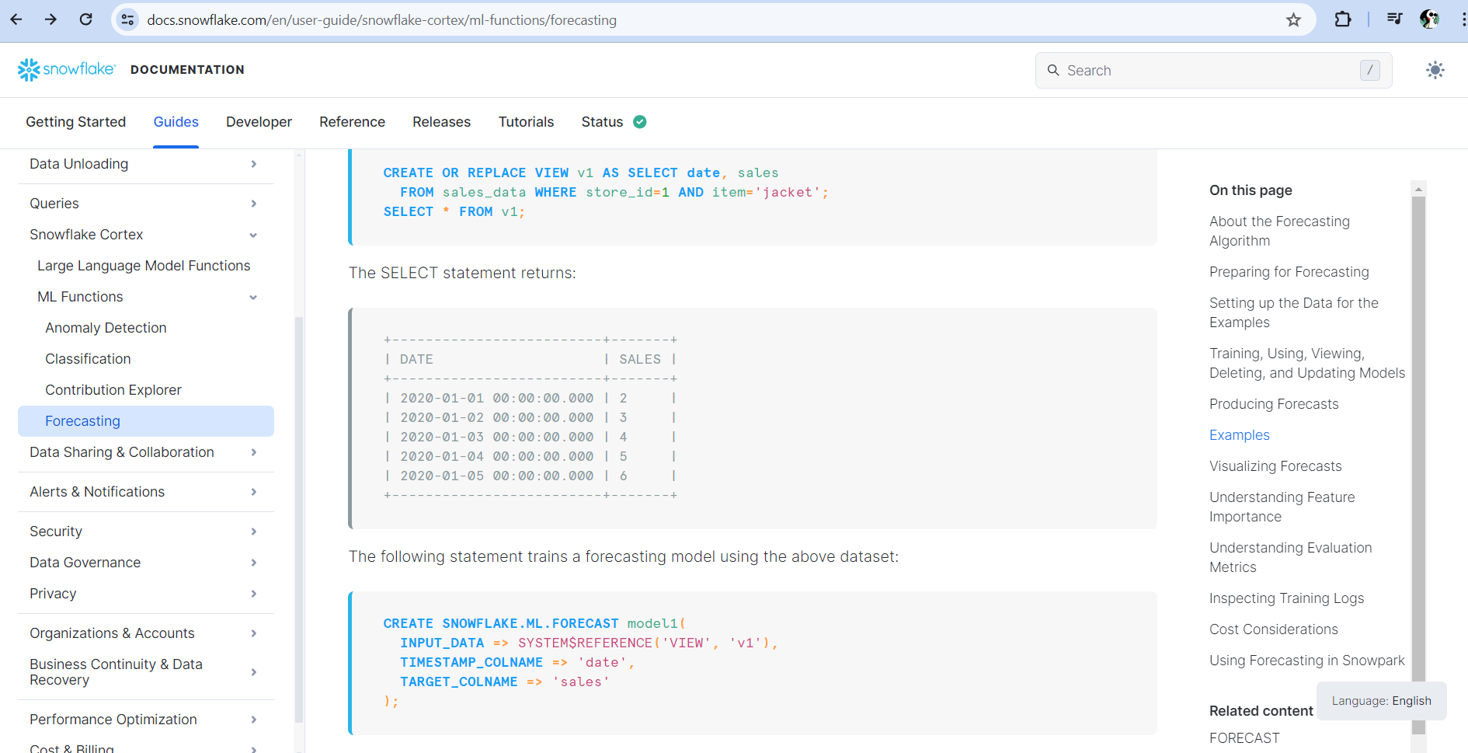
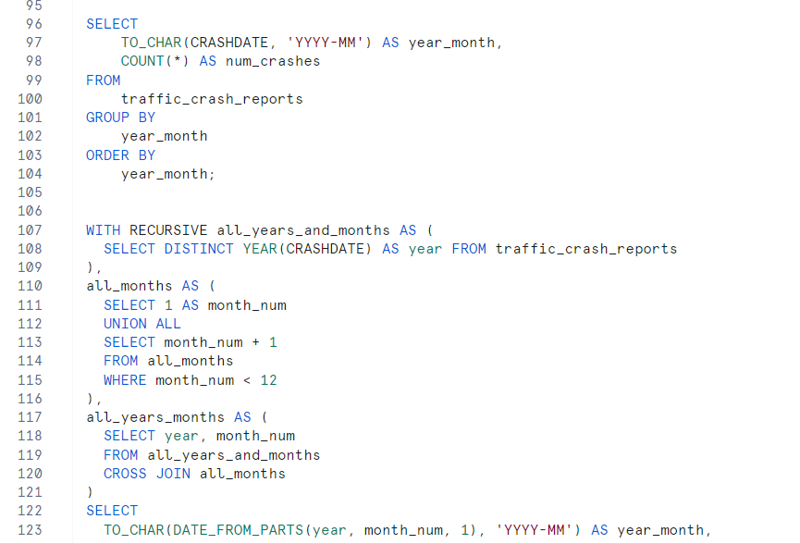
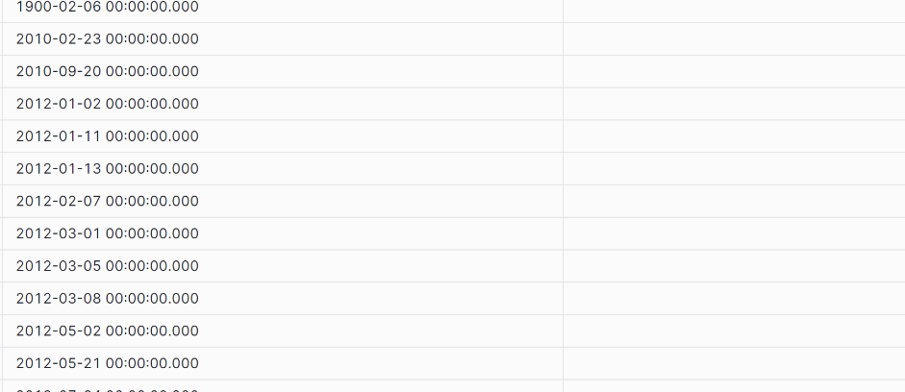
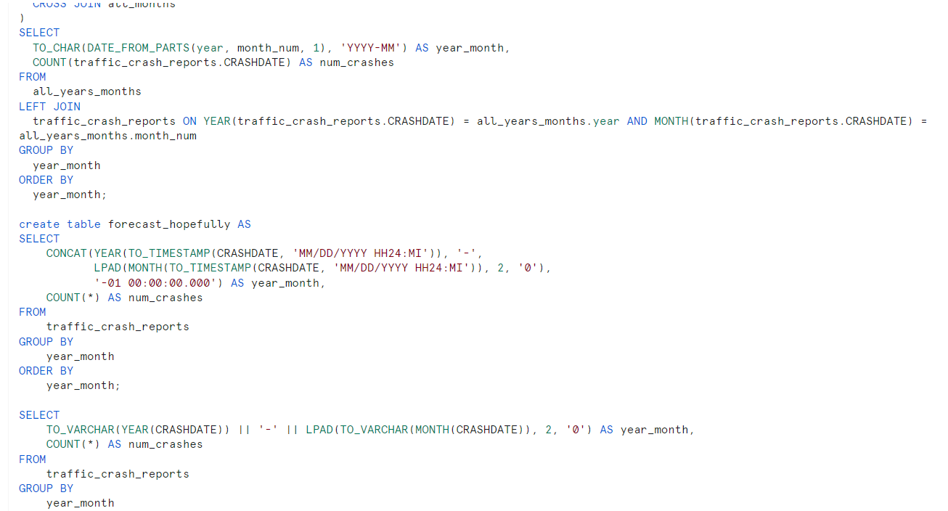
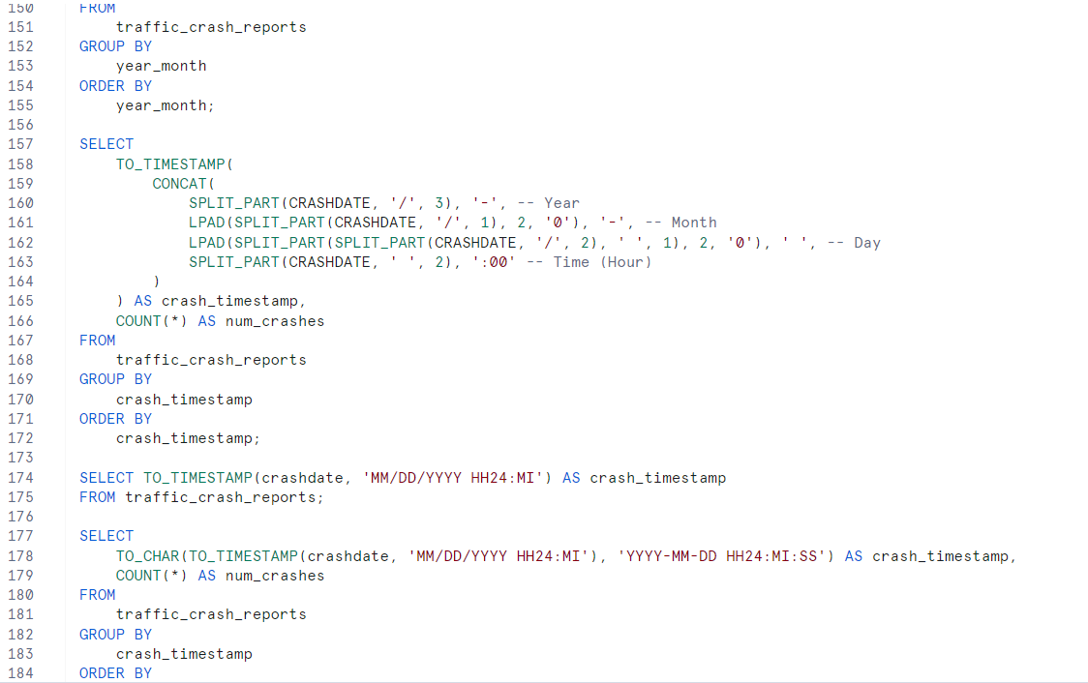
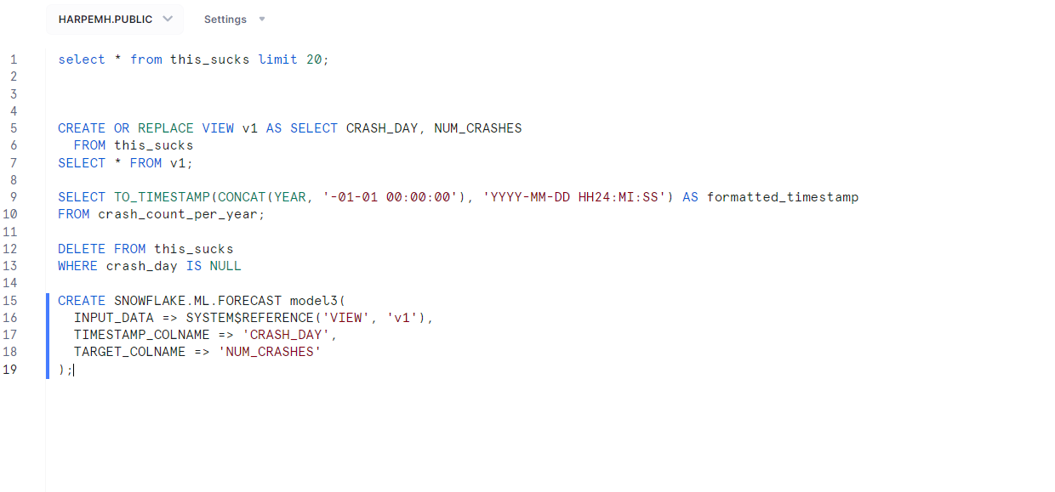
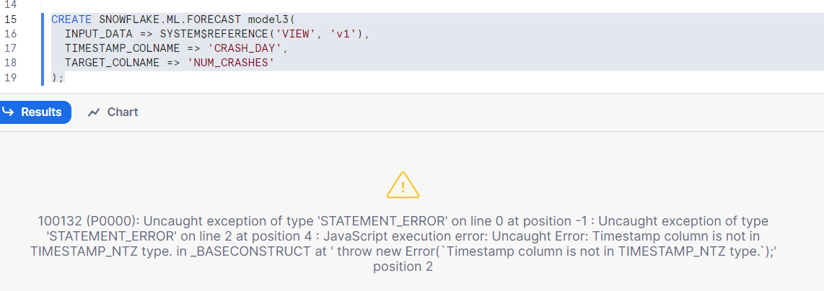
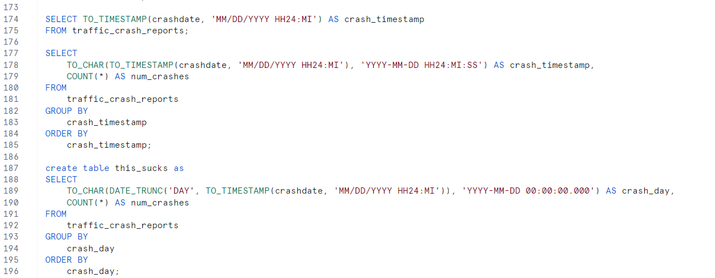
I tried: Predictive analytics – 4 hours

Slide 7
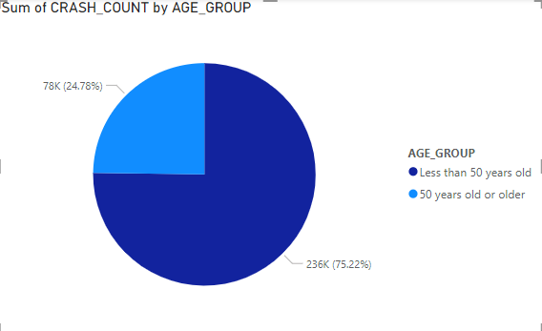
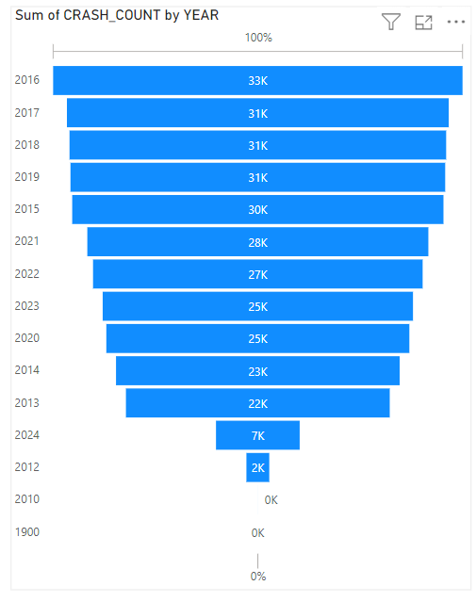
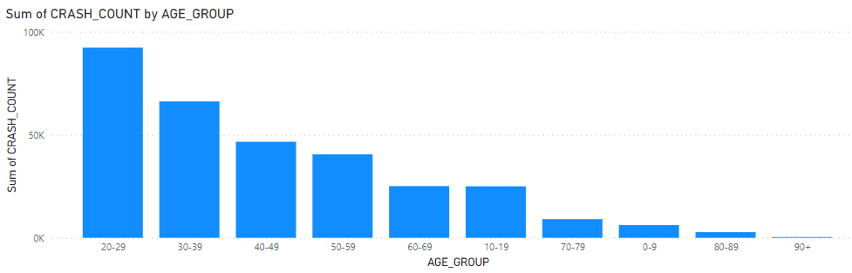

Slide 8
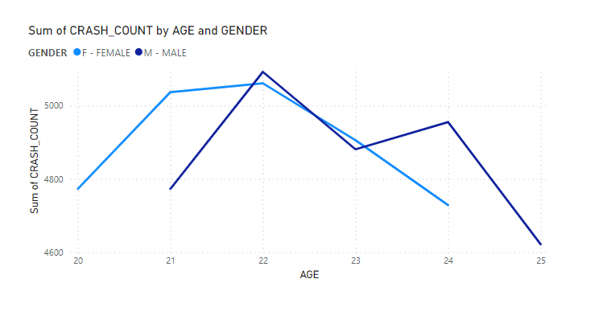
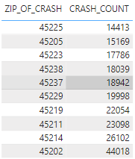
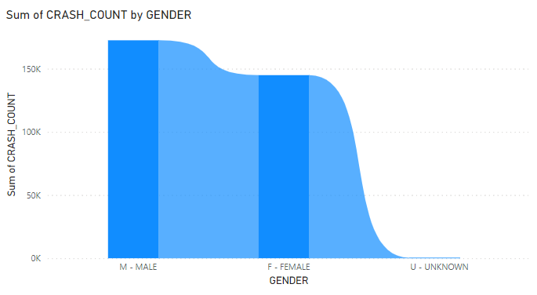
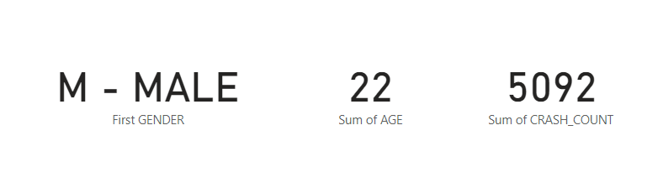

Slide 9
Summary
After analyzing the data set on traffic crash reports, there were several things learned. To start, the original question I wanted to answer was “Who is most likely to get into an accident and will accidents increase or go down over the next 15 years”. Starting with the first part, I created several queries, visualizations, and tables to help answer the question of who is most likely to get into an accident. To begin, I looked at age groups of <50 and >50. Out of the numerous amounts of crashes, 75% of them were caused by people under 50 years of age. Deciding to dive deeper, I looked at the number of crashes for every 10 years of age. It was interesting to find that people in their 20s had the greatest number of accidents, and people 80+ had the least. Looking into gender analytics ends up showing that males have the greatest number of crashes in their 20s however females are close behind. It also seems that at some point, females take over for the greatest number of crashes after males reach about 25. Finally, I decided to investigate which zip code area had the most crashes. This would help us limit the scope of the area where there may be stress zones for drivers. After analyzing the top ten, there was a clean winner of 45202. It had almost double the number of crashes below it. I wanted to also determine the number of accidents that would occur each year for the next fifteen years. However, after attempting for four hours, I decided to throw in the towel. From what I saw in the trend of count for each year, the number of crashes with continue to increase, however, it seems to be decreasing with each year. At some point within the next 50 years, I assume that there will be a switch were the number of crashes starts to go down each year.

Slide 10

THANK YOU

